Slide 1
UNIT-4
BRANCH and BOUND

Slide 2
Branch and Bound
The term branch and bound refers to all state space search methods in which all children of the E-node are generated before any other live node can become the E-node.
Two graph search strategies, BFS and D-search, in which the exploration of a new node cannot begin until the node currently being explored is fully explored.
Both of these generalize to branch and bound strategies.
In branch and bound terminology, a BFS –like state space search will be called FIFO(First In First Out) search as the list of live nodes is a First In First Out list (or queue)
A D-search like state space search will be called LIFO(Last In First Out) search as the list of live nodes is a Last In First Out list (or Stack).
Bounding functions are used to help avoid the generation of subtrees that do not contain an answer node.

Slide 3
Branch-and-Bound
It is efficient in the average case because many branches can be terminated very early.
Although it is usually very efficient, a very large tree may be generated in the worst case.
Many NP-hard problem can be solved by B&B efficiently in the average case; however, the worst case time complexity is still exponential.

Slide 4
Branch-and-Bound
Backtracking uses a depth-first search with pruning, the branch and bound algorithm uses a breadth-first search with pruning.
Branch and bound uses a queue as an auxiliary data structure.
Starting by considering the root node and applying a lower-bounding and upper-bounding procedure to it.
If the bounds match, then an optimal solution has been found and the algorithm is finished.
If they do not match, then algorithm runs on the child nodes.

Slide 5
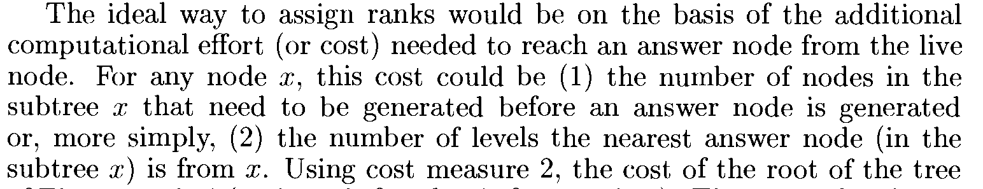
Branch-and-Bound
Least Cost (LC) Search :
In both LIFO and FIFO branch and bound, the selection rule for the next E-node is rather rigid and in a sense blind.
The selection rule for the next E-node does not give any preference to a node that has a very good chance of getting the search to an answer node quickly.
The search for an answer node can often be speeded by using an Intelligent ranking function C^(.) for live nodes.
The next E-node is selected on the basis of this ranking function.

Slide 6
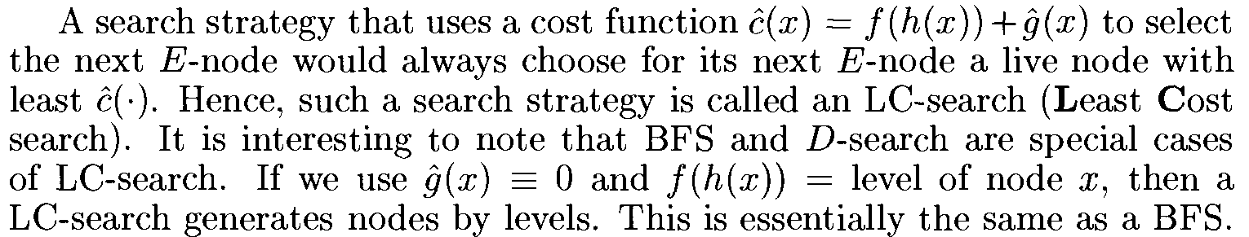
Branch-and-Bound

Slide 7
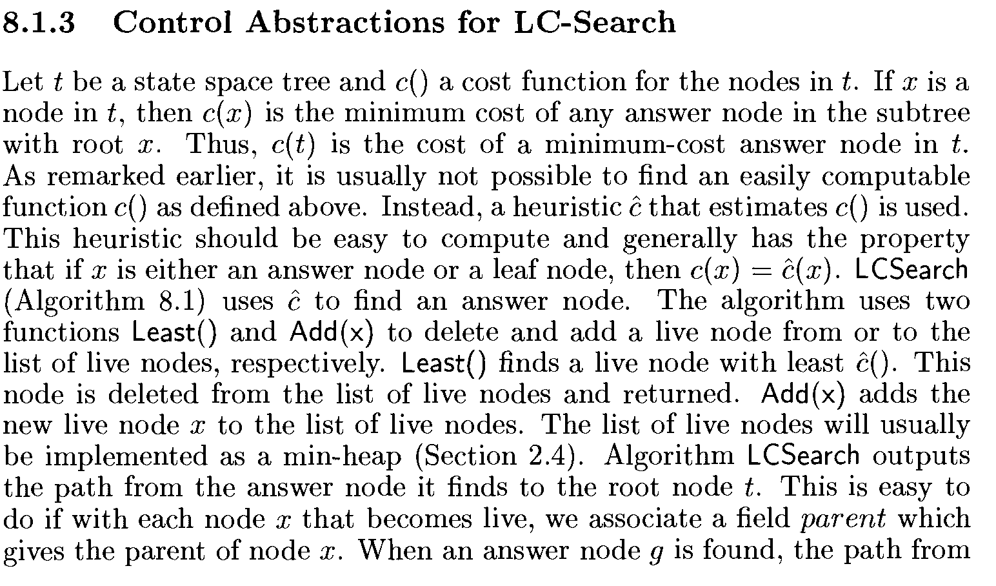

Slide 8
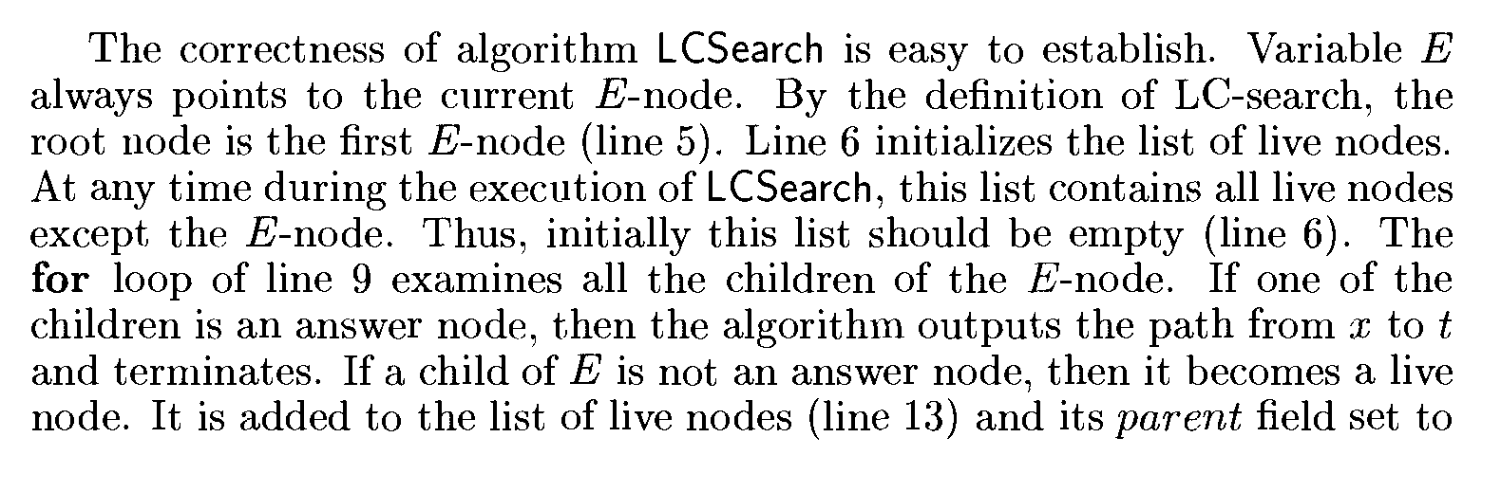
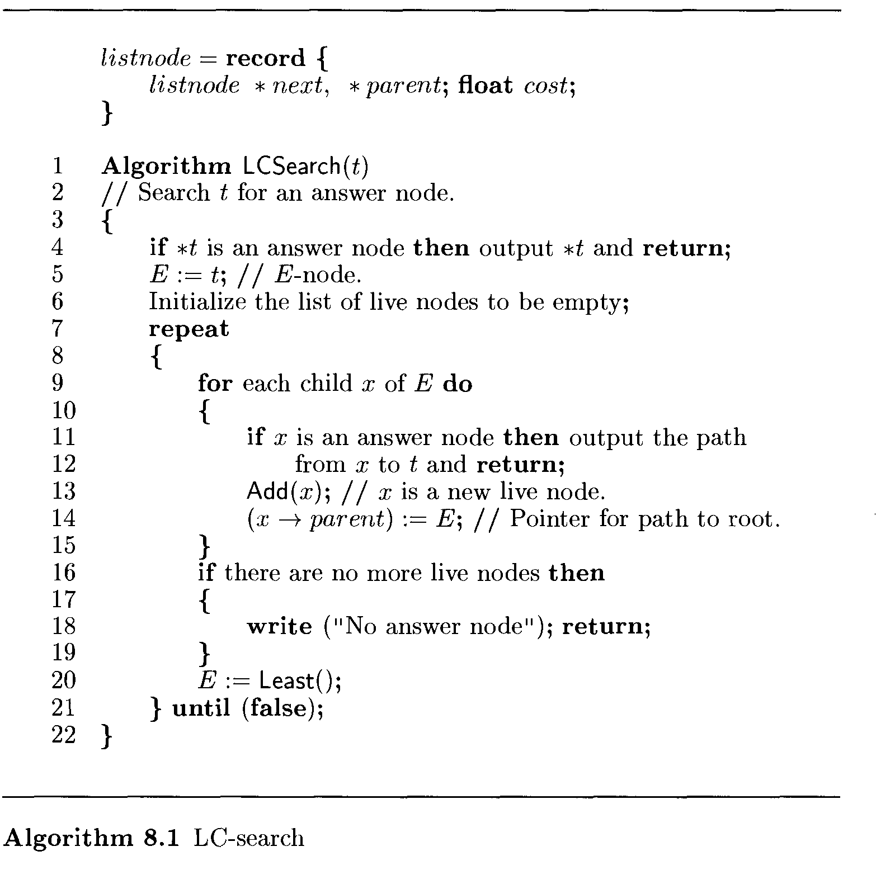
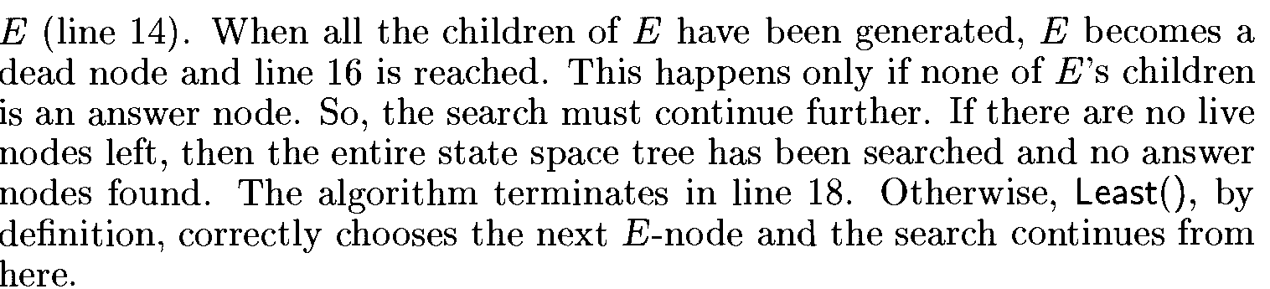

Slide 9
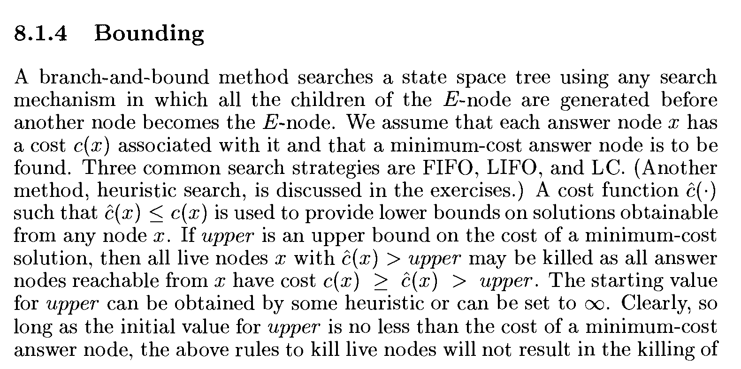

Slide 10
0/1 Knapsack problem
Given ‘n’ positive weights W_{i}, n positive profits P_{i}, and a positive number ‘m’ that is the knapsack capacity, this problem calls for choosing a subset of the weights such that
Σ _{1≤i≤n} W_{i}X_{i} ≤ m and Σ _{1≤i≤n} P_{i}X_{i} is maximized.
The X_{i}’s constitute a zero-one-valued vector.
The solution space for this problem consists of the 2^{n} distinct ways to assign zero or one values to the X_{i}’s.
Backtracking algorithms for the knapsack problem use bounding functions that are needed to help kill some live nodes without expanding them.
A good bounding function for this problem is obtained by using an upper bound on the value of the best feasible solution obtainable by expanding the given live node and any of its descendants.
If this upper bound is not higher than the value of the best solution determined so far, then that live node can be killed.

Slide 11
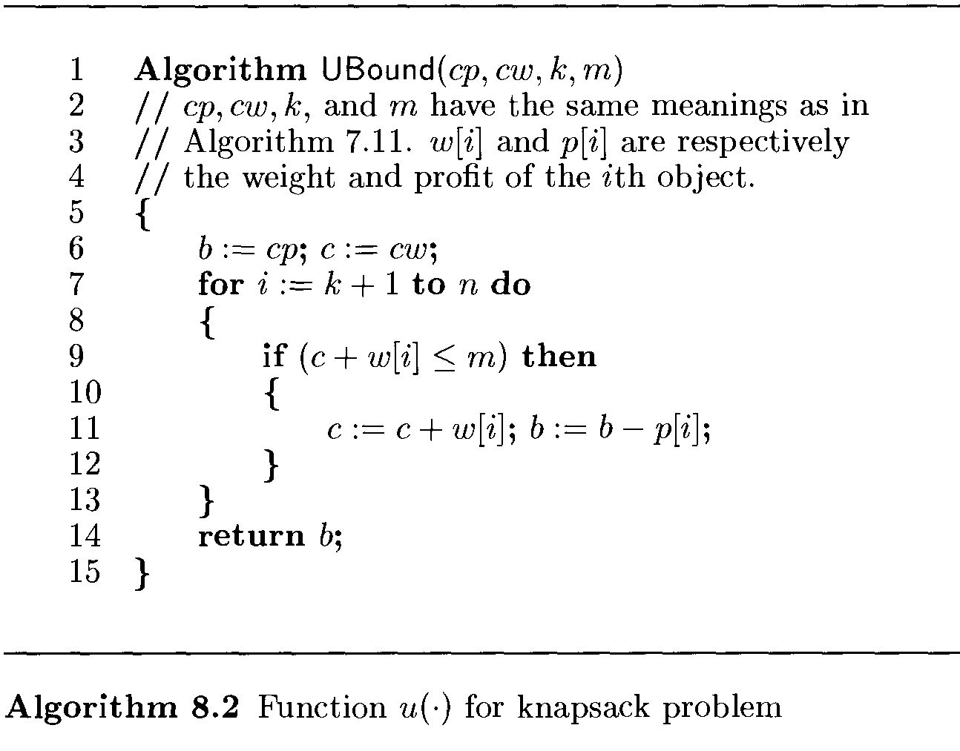

Slide 12
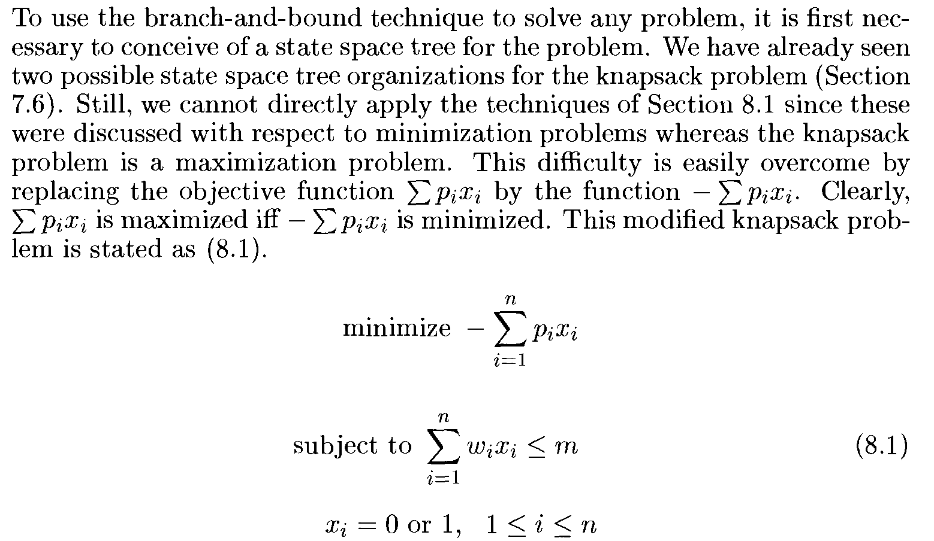
0/1 Knapsack problem
LC (LIFO) based branch and bound algorithm with an appropriate C(.) & U(.) as LC branch and bound i.e. (LIFOBB) Last In First Out Branch and Bound.

Slide 13
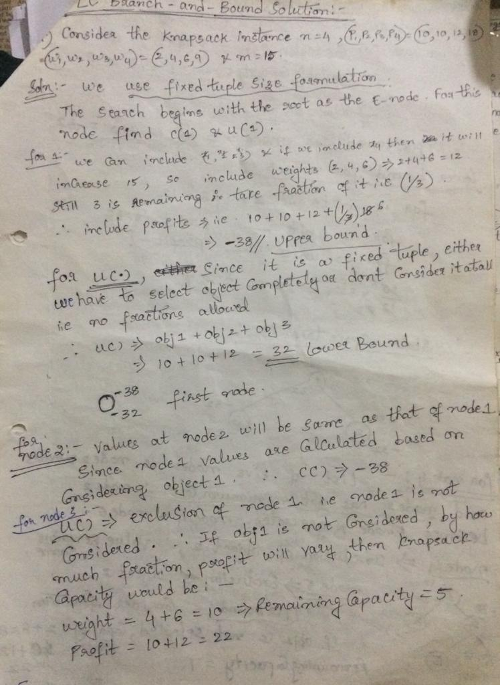

Slide 14
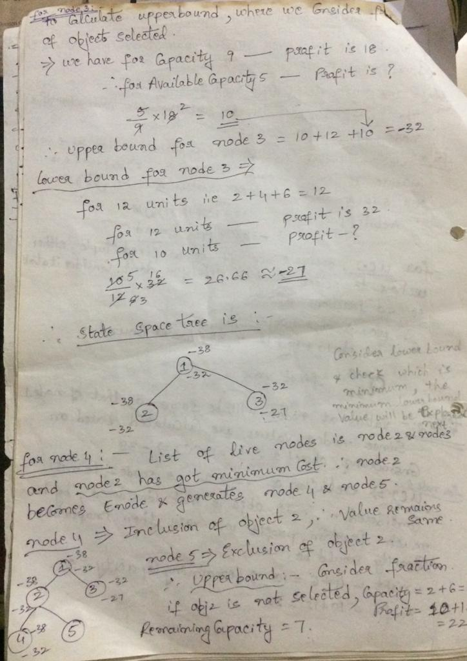

Slide 15
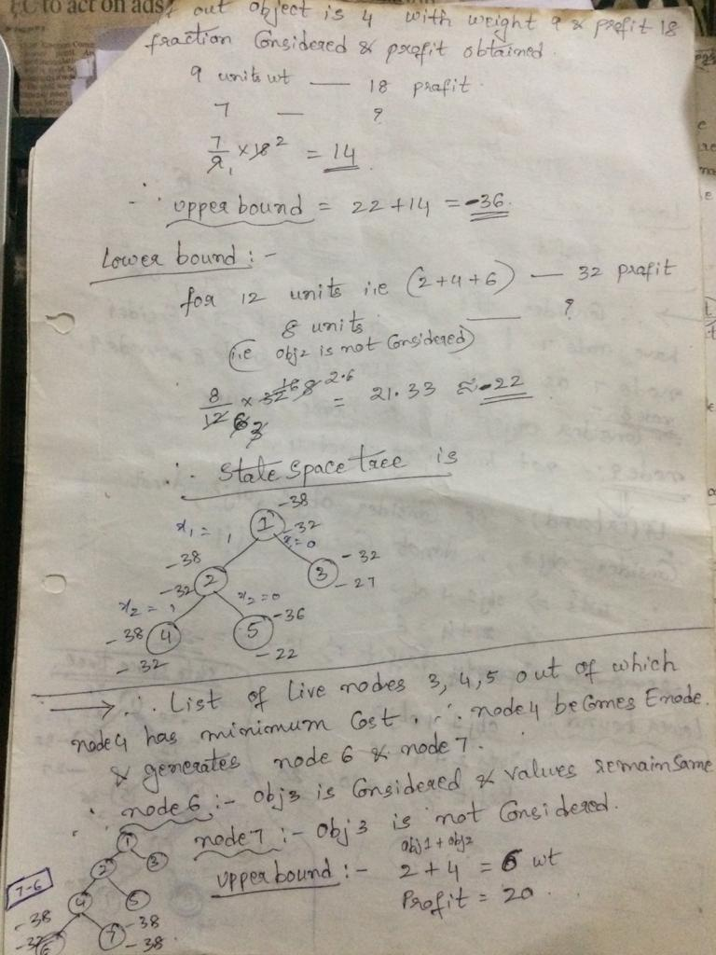

Slide 16
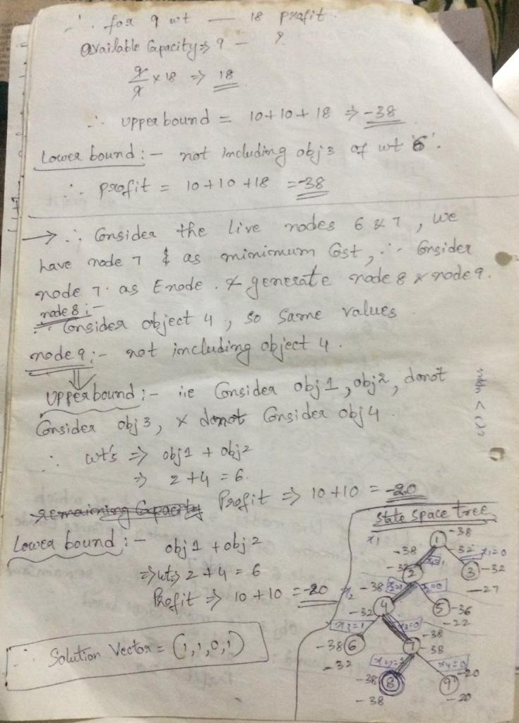

Slide 17
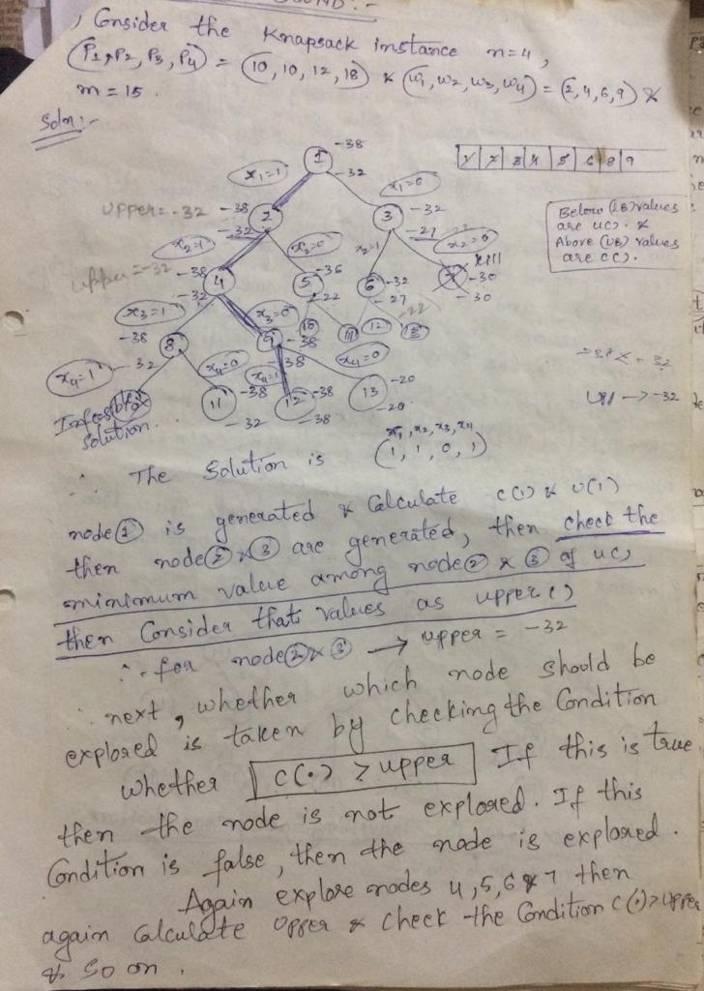
FIFO Branch and Bound

Slide 18
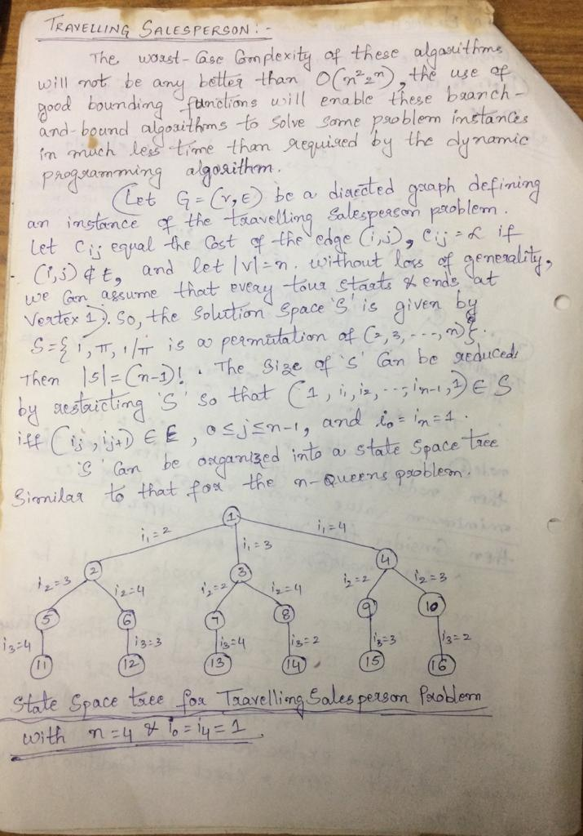

Slide 19
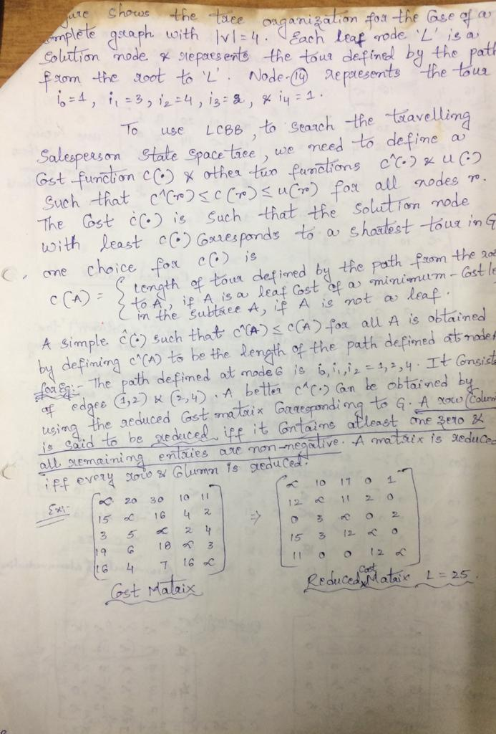

Slide 20
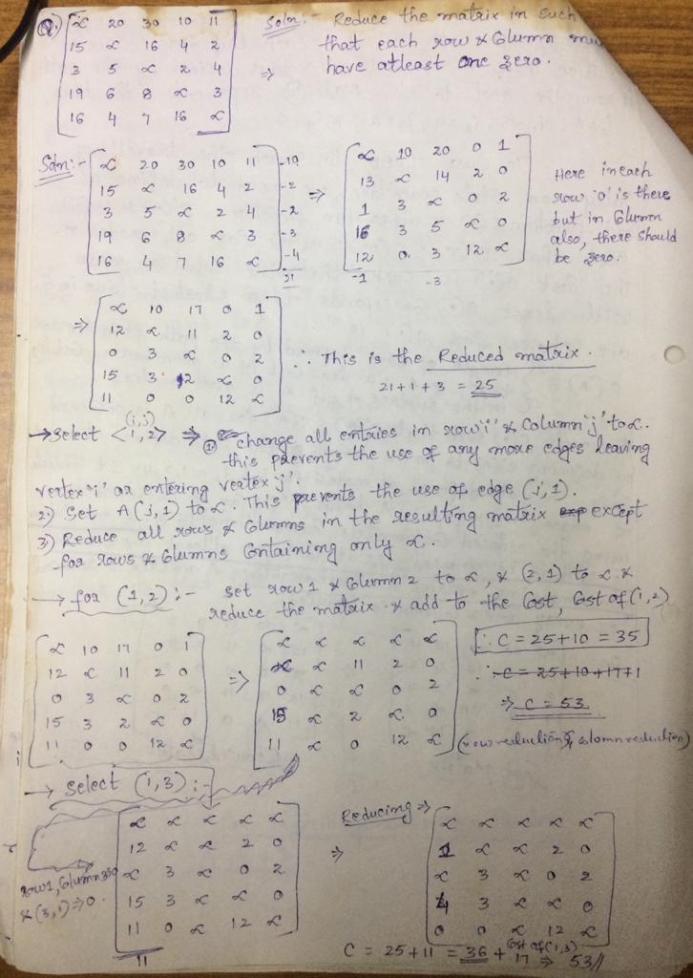

Slide 21
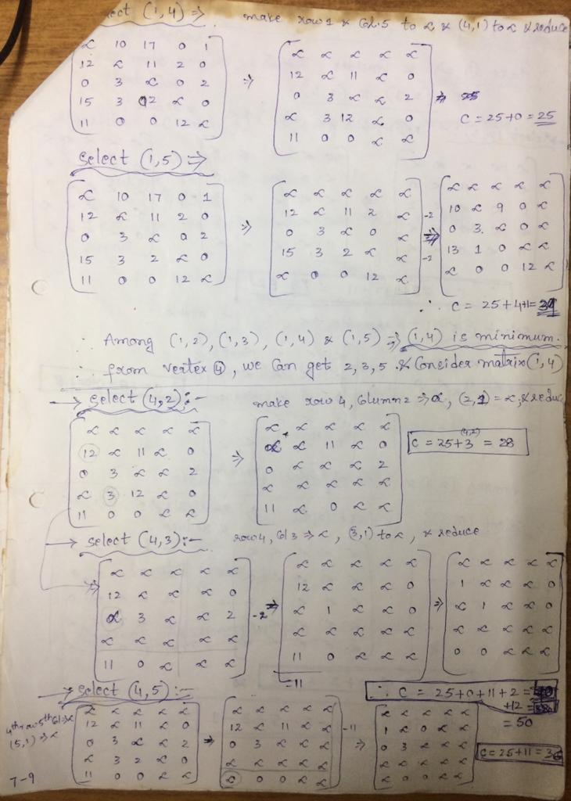

Slide 22
